Slide 1
Unit 2: Introduction to Methods

AP CS A
Ms. Baniqued

Slide 2


What is a method?
A method is a set of instructions that can be used upon request.
The main method is generally a starting point of all Java application programs. When you run your program, the main method is called by default.
Some methods have parameters, or arguments, special variables that receive information that we pass, or send to a method. Parameters give programmers choices when using methods.
When you use a method, we refer to it as calling or invoking a method.
Method
Argument(s)
Method Call

Slide 3
Method example:
public static void throw(String item) {
System.out.println(“He threw a ” + item);
}
“ball”
throw(“ball”);
Console Output: He threw a ball

Slide 4

What if we change the argument?
public static void throw(String item) {
System.out.println(“He threw a ” + item);
}
“bell”
throw(“bell”)
Console Output: He threw a bell

Slide 5
Procedural vs. Functional Methods
A procedural method does not return a value. A functional method does. You can think of a procedural method as a command, and a functional method as an answer to a question.
To “return a value” means to give back a result. If I “tell” a procedural method to do something, it will do it. If I “ask” a functional method to do something, it will give me the finished product.
Procedural methods have a return type of void. Procedural methods will not return a value, but these methods can:
Print output to the console
Modify a ‘global’ value, a variable that exists outside of the method
Call another method
Functional Methods can have a return type such as int, double, String, etc. You can assign a functional method call to a variable.
Example:
String name = generateName(10); //generates a random name of length 10

Slide 6

The “Method Template”
modifier static return-type methodName(list of parameters) { … }
modifier - public or private
static - means the method is not associated with an object…we’ll get back to this later)
return-type – can be void, a primitive data type, or an Object type such as String)
methodName - follows the same guidelines as variable names)
list of parameters – a list of all the data you will be sending into the method (can be empty)

Slide 7
Java Built-In Methods (String Methods)
For Java Built-In Methods, we do not have to write the code for these methods, nor do we need to access/import another library or class.
Method Header | Description
int length() | Returns the number of characters in a String object.
boolean equals(String other) | Returns true if this String is equal to the String referenced by the parameter other, false otherwise.
String substring(int from) | Returns the substring beginning at index from and ending at index to - 1.0 <= from <= to <= length()
String substring(int from, int to) | Returns the substring beginning at from and ending at length() – 1. Equivalent to substring(from, length()). 0 <= from <= length()
int indexOf(String str) | Returns the index of the first occurrence of str or -1 if str is not found. The first character of a String is at index 0. The last character of a String is at length() - 1.
int compareTo(String other) | Returns: - a negative int if this String is less than other’s String - 0 if this String is equal to other’s String - a positive int if this String is greater than other’s String

Slide 8
String compareTo examples
String str1, str2; int result; //positive, negative, or zero
Example | Result
str1 = "same"; str2 = "same"; result = str1.compareTo(str2); | 0
str1 = "same"; str2 = "same"; result = str2.compareTo(str1); | 0
str1 = "apple"; str2 = "zebra"; result = str1.compareTo(str2); | negative (a < z)
str1 = "apple"; str2 = "zebra"; result = str2.compareTo(str1); | positive (z > a)
Example | Result
str1 = "apple"; str2 = "apply"; result = str1.compareTo(str2); | negative (e < y)
str1 = "apple"; str2 = "Apple"; result = str1.compareTo(str2); | positive (a > A)
str1 = "apple tree"; str2 = "apple"; result = str1.compareTo(str2); | positive

Slide 9
Using the Math Class
The Java Math class is a built-in class in the java.lang package that provides a collection of mathematical functions and constants.
* All of the Math class methods and constants are static, which means you can directly access them using the class name without creating an object. (Unlike the String methods).
Method Header | Description
static int abs(int x) | Returns the absolute value of x as an int
static double abs(double x) | Returns the absolute value of x as a double
static double pow(double base, double exponent) | Returns base^exponent
static double sqrt(double x) | Returns the square root of x
static int random() | Returns a double in the range [0.0, 1.0) From 0.0 up to but not including 1.0

Slide 10
Autoboxing and Unboxing (Wrapper Classes)
Primitive data types store only single values. Examples: 10, 22.5, true
Reference types store only references. Examples: String, Scanner, ArrayList
In Java, the wrapper classes, such as Integer and Double, are used to convert primitive types into reference types
Java 5.0 added autoboxing; autoboxing is accomplished without having to call a constructor or method of a corresponding object wrapper class.
Autoboxing is the automatic conversion that the Java compiler makes between primitive types and their corresponding object wrapper classes.
Unboxing in the automatic conversion that the Java compiler makes from the wrapper class to the primitive type.
Every primitive data type in Java has a corresponding wrapper class. AP CS A only tests you on Integer and Double.
Since Wrapper Classes are reference types, they are stored in the Java heap.

Slide 11
Review
Method
Procedural Method
Functional Method
Modifier
Return, Return Type
Parameter or Argument
Parameter List/Argument List
Built-in Methods
Math class methods
Java Expression
String Pool
De Morgan’s Law
Overloaded Method
Wrapper Class
Autoboxing, Unboxing
String methods()
int length()
boolean equals(String other)
String substring(int from)
String substring(int from, int to)
int indexOf(String str)
int compareTo(String other)

Slide 12
Unit 2: Introduction to Classes and Objects

AP CS A
Ms. Baniqued

Slide 13
So far, where have we heard the term ‘class’ or ‘object’?

Slide 14
So far, where have we heard the term ‘class’ or ‘object’?
Scanner class, Scanner object
String class, String object
Math class
Wrapper class
Class declaration
.class file
Based on our previous use, what would you say is the difference between a class and an object?

Slide 15
What is a Class?
A class is a piece of the program’s source code that describes a particular type of objects. A class is a fundamental building block of Object-Oriented Programming (OOP) and provides a way to encapsulate the state and behavior of an object.
In Java, a class serves as a blueprint or template for creating objects, which are instances of that class.
For example, a Car class contains the code that defines a Car’s data fields and methods (state and behavior). Several Car objects can represent different types of cars (cars with difference appearances or features/functions).

Slide 16
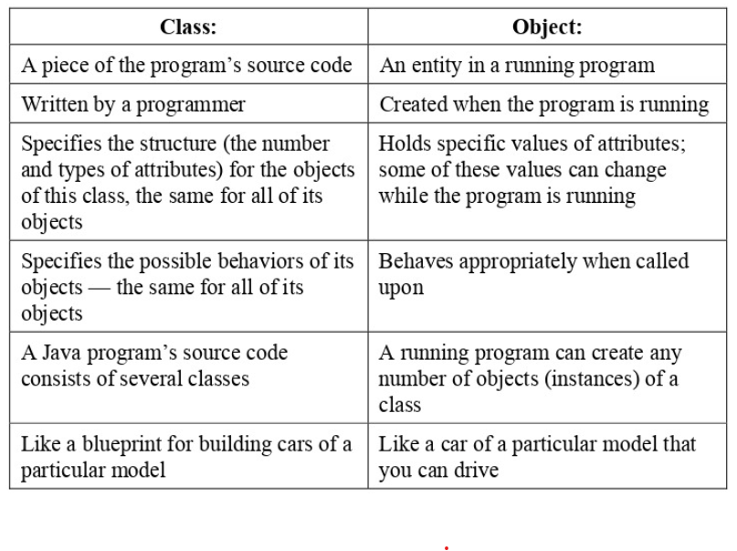
Class vs. Object

Slide 17
What is a class supposed to do?
A class name must match the name of the file (case sensitive). For example, a class Flower must be stored in a file named Flower.java.
In Java, a class describes 3 aspects that every instance (object) of this class has:
The data elements of an object of this class (These are called instance variables, fields, or attributes)
The ways in which an object of this class can be created (Procedures for creating an object are called constructors)
What this type of object can do (Methods)
Not every class has fields, constructors, and methods explicitly defined: some of these features might be implicit or absent.
VIEW CODE: Car.java and CarTest.java
Notes:
Open Car.java

Slide 18
Why use classes in Java?
Encapsulation: A class allows you to group related data (fields/attributes) and behavior (methods) together, which makes it easier to organize and maintain your code. Encapsulation promotes information hiding, meaning the internal state (attributes) of an object is protected from outside manipulation, and access is only granted through public methods. Only you, the programmer of Car.java, can define what a Car is or not.
Abstraction: By encapsulating the data and behaviors of an object, a class allows you to abstract away the complexity of the object by providing a simple interact to interact with. When you write code with classes, you can create objects that represent higher-level concepts in code, hiding the low-level implementation details.

Slide 19
Fields (Instance Variables or Attributes)
Instance variables are also called data fields, or fields, coming from the analogy with fields in a form that can be filled in with different values.
A field follows the format:
modifier data-type identifier;
Each field has a name, given by a programmer, and a type. For example, our Car class has 4 fields:
private String make; private String model; private int year; private double mileage;
In AP CS A, fields should always be private.

Slide 20
Fields (Instance Variables or Attributes)
Fields are never initialized when they are declared at the top of the class. They are always initialized in a constructor or another class method.
Unlike local variables, instance variables are given the zero-value as a default value when they are declared.
private String make; // default value null private String model; // default value null private int year; // default value 0 private double mileage; // default value 0.0
// boolean default is false
// char default is '\u0000’ which represents null
null is a reserved word (keyword) in Java for literal values. It is just a value that shows that an object is referring to nothing. If a reference type is set to null, memory is not allocated on the heap.
Fields have a global scope, which means they can be accessed by the whole class.

Slide 21
Creating Objects using a Constructor Call
An object, or an instance of a class, is created with the new operator, which invokes (calls) one of the constructors defined in the object’s class.
To create an instance of the Car class, we can invoke its default, no-args constructor:
Car myCar = new Car();
A constructor must always have the same name as its class. A constructor can accept no parameters or any number of parameters, as long as a class has a constructor that matches the expected parameter list.
For example,
Car myCar = new Car(4, 5);
would be an invalid line of code, since our Car class does not have a Car(int, int) constructor.

Slide 22
Writing Constructors
A constructor header consists of:
The keyword public, which means that other class methods can use this class to create objects. Constructors are always public.
The name of the constructor, which is always the same name as the class.
The parameter list, a list of parameters that accept values from the constructor call. This can be empty.
Fields are never initialized when they are declared at the top of the class. They are always initialized in a constructor or another class method.
// Default no-args constructor public Car() { this.make = DEFAULT_STR; this.model = DEFAULT_STR; this.year = 0; this.mileage = 0; } // Constructor with 4 parameters, 1 for // each field public Car(String make, String model,
int year, double mileage) { this.make = make; this.model = model; this.year = year; this.mileage = mileage; }

Slide 23
Review
Constructor
Invoking or Calling a Constructor
new keyword
Instantiation
Abstraction
Fields/Attributes/Instance Variables
Global scope
Type signature/method signature/method header
Class
Object (or instance)
Class API
Object-Oriented Programming (OOP)

